Slide 1
Lan design
By Cashel Mc Daid, Oisin Gibson, Fionntán Doherty, Jake Doran, Brian Carlin, Michal Kubisiak

Slide 2
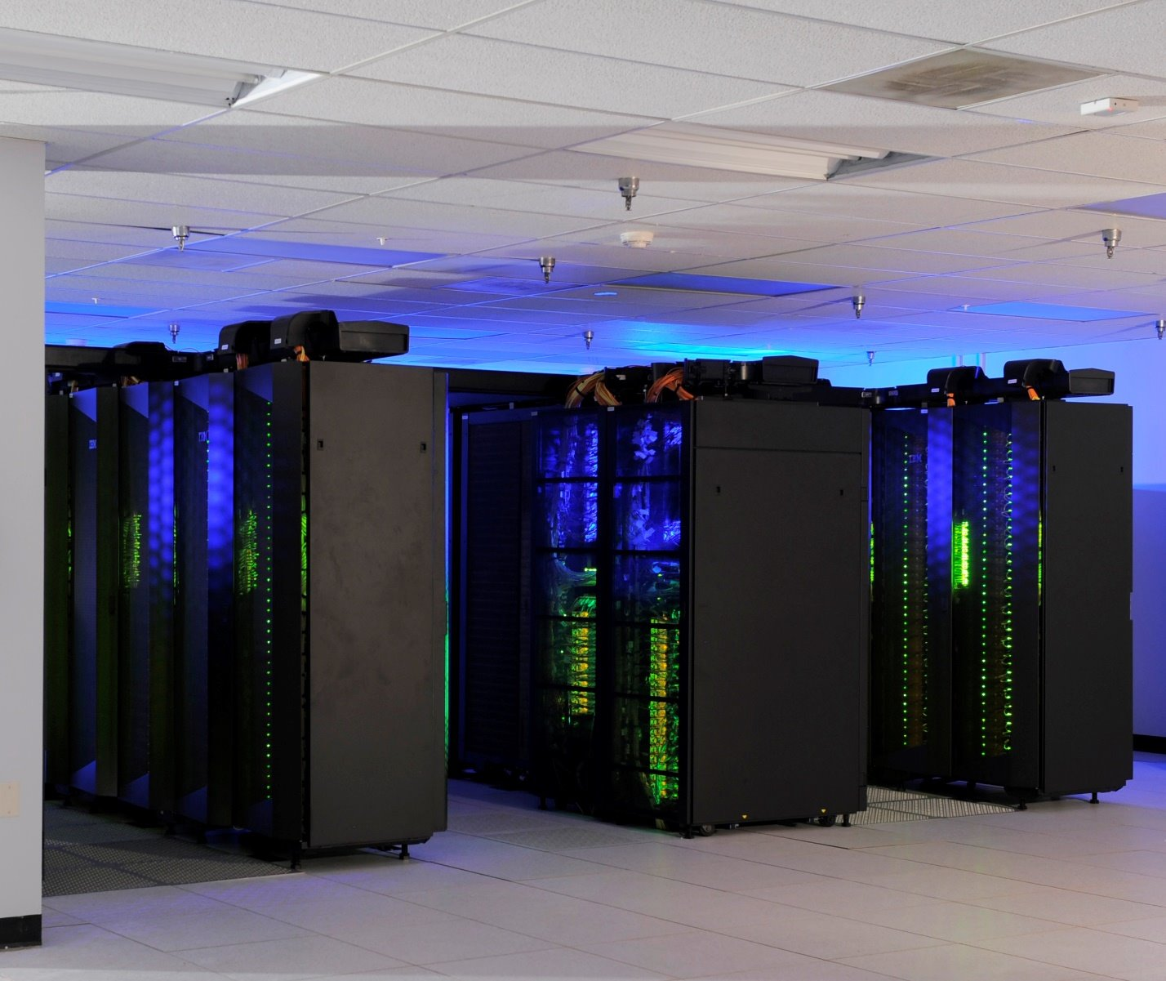

Introduction
The purpose of this presentation is to thoroughly showcase how we, as a group, would design a LAN for the Letterkenny ATU with the information we have gathered.
We will discuss in detail our vision, the steps we would take to achieve this design, and the reasoning behind our choices.
It is crucial to demonstrate not only our understanding of LAN design concepts but also our ability to apply them practically throughout this presentation.
Through this presentation, we aim to highlight our comprehensive knowledge and problem-solving approach we put together this presentation with.
We all decided early on who would get what for this assignment through collaboration and communication and then worked off that information.
I hope you enjoy this and find it insightful and engaging.

Slide 3
Cabling
In Discussion:
I am going to be talking about types of cables and cable components with reference to Vertical and Horizontal Cabling.
10GB
Firewall
10GB
Router
100GB
HES
100GB
LES
HES
HES
10GB
1GB
PC
100GB
1GB
PC
1GB
PC
1GB
PC

Slide 4

Cabling Type(Copper Cables)
We plan on using CAT 6 Shielded Twisted pair cables because of the speed and durability of these cables to avoid any physical damage or electromagnetic interference the issues we face with this is cost and flexability but with this we are sure to be future proof, which is what we are working towards. These cables will primarily be used between devices and Low-end switches.

Slide 5
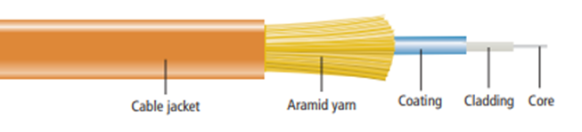
Cabling Type(Fiber Optic)
We are then going to use fiber cabling for our back-bone cabling. Multimode fiber cables for around the campus connecting our IDFs and MDF, then single mode fiber for connecting the MDF to the IDFs in the CoLab.

Slide 6
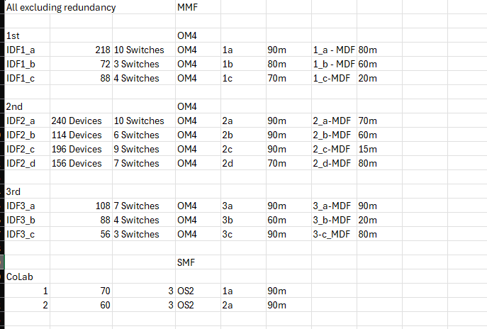
Wire List
This wire list shows each IDF broken down, the number of devices and switches are labelled. The distance the IDF reaches is recorded and their distance from the MDF is also labelled. The Cables for on the campus are Multimode Fiber cables and we are using OM4 cables then connecting our Campus to the CoLab we are using SMF OS2.

Slide 7

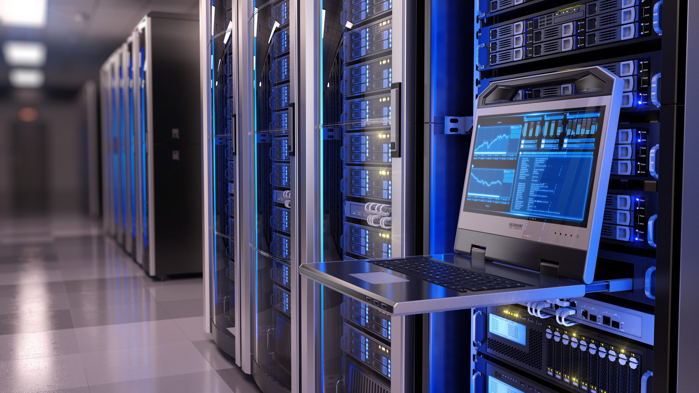
Main Distribution Frame (MDF)

Slide 8
What Is a Main Distribution Frame (MDF) Room?
A Main Distribution Frame (MDF) is a central network hub. It is essential for a smooth flow of data, allowing better connectivity across all networks and ensuring seamless operations.
The MDF is pivotal in any networking environment as it serves as the central point where all communication lines congregate. This includes communication devices like data cables, internet connections, and telephone lines which we don’t really use anymore in the Letterkenny ATU.
At Letterkenny ATU, the MDF room integrates all incoming and outgoing communication lines across the campus. The physical MDF is a panel where communications from different parts of the campus are concluded or connected.
From the MDF, cables are routed to individual offices, rooms, or areas via Intermediate Distribution Frames (IDFs) or network switches, ensuring effective distribution of network resources.

Slide 9
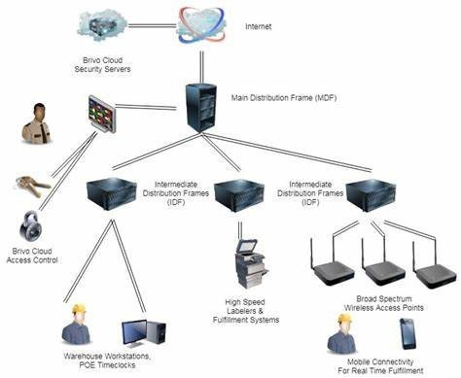
What makes a good Main Distribution Frame (MDF) Room?
Clear Identification in the MDF Room
Use clear, color-coordinated labels on hardware for easy identification.
Labels should include essential info only (e.g., IP address, device name, purpose).
Implement a consistent naming template for cables, with matching identifiers on both ends.
Use rack-mounted trays or shelves for smaller components.
Ensure proper spacing for airflow and easy maintenance.
Frequently review and adjust setup as needed for new or upgraded equipment.

Slide 10
What makes a good Main Distribution Frame (MDF) Room?
Safety and Maintenance
Security Measures: Limit access with control systems, biometric scanners, and cameras.
Fire Protection: Install suitable fire suppression systems (extinguishers, sprinklers).
Inspect systems regularly to ensure functionality.
Regular Maintenance:
Conduct periodic inspections, clean hardware, and check wiring.
Monitor temperature and humidity for optimal performance.
Power and Cooling for a Better MDF
Power Needs: Evaluate the power requirements of all equipment to prevent circuit overloads.
Power Redundancy: Use UPS to maintain uptime during outages.
Cooling Solutions: Choose HVAC systems tailored for IT; monitor temperatures regularly.
Airflow Management: Ensure proper ventilation to disperse heat effectively.

Slide 11
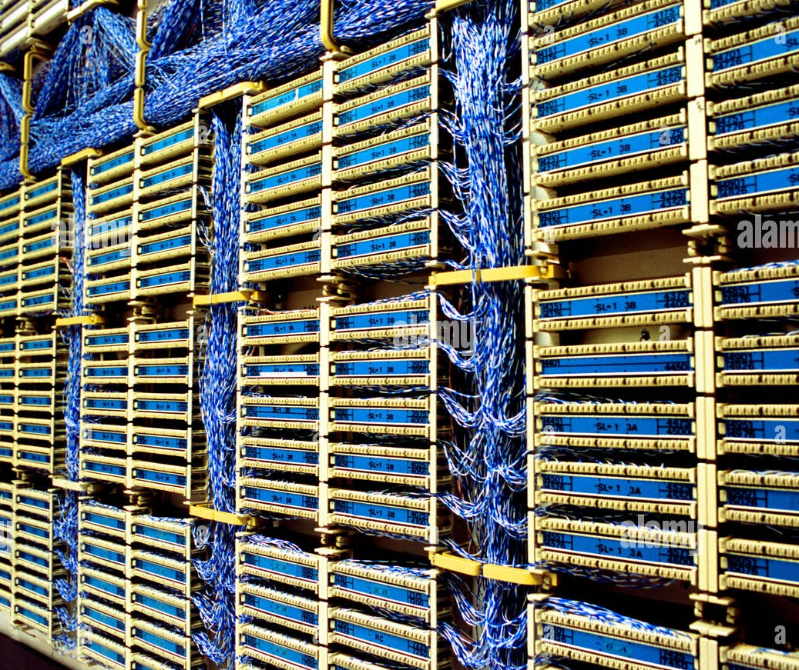
What makes a good Main Distribution Frame (MDF) Room?
Additional Things To keep in Mind for a MDF Room
Elevated Floors: Neatly route cables and improve cooling while preventing water damage.
No Carpet: Use anti-static flooring to avoid static electricity and dust buildup.
Outside Wall: Easier installation of cooling units and cable routing.
No EMI Interference: Minimize connectivity issues caused by electromagnetic interference.
Room to Expand: Ensure space for future upgrades and long-term growth.

Slide 12
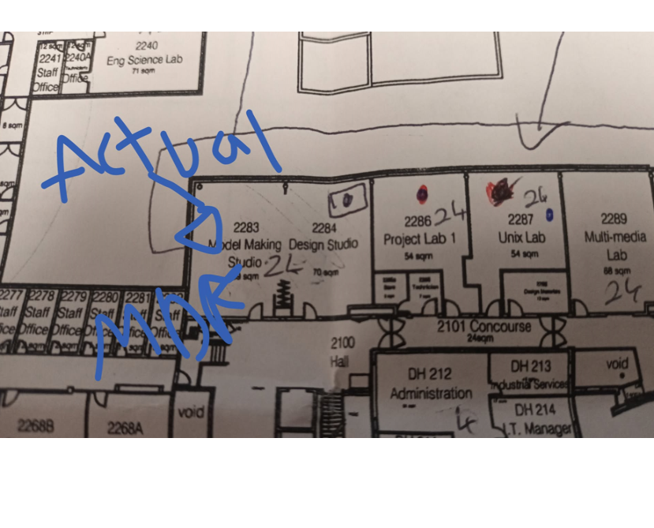
Why This Room was Chosen
Room for Expansion: Space available for future upgrades or additional equipment.
Central Location: Positioned within 200 meters of most of ATU Letterkenny, making it an optimal hub and great positioning for it.
Outside Wall: Ideal for easier cooling unit installation and cable management.
No Carpet: Cost-effective flooring reduces static and allows funds to be allocated elsewhere as no carpet originally here.
Second Floor: This Elevated position minimizes risk of flooding during severe weather.

Slide 13
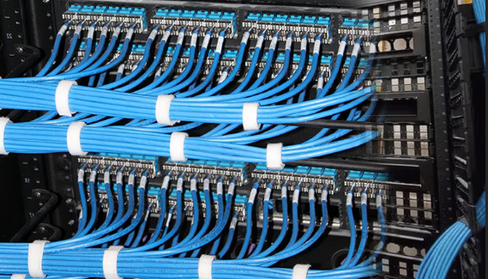
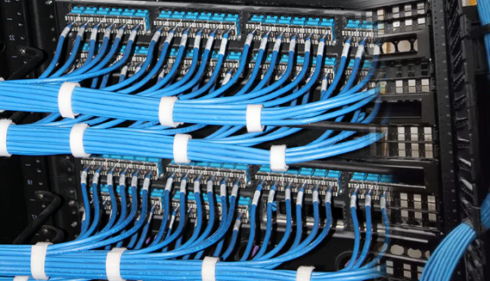

Intermediate distribution frame (idf)

Slide 14
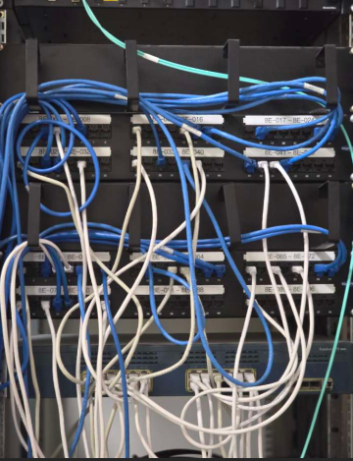
WHat IS An Intermediate distribution frame (idf)?
An IDF (intermediate distribution frame) is a free-standing or wall-mounted rack used to create a connection between end user devices (e.g. PCs, printers, routers, VoIP phones) and the MDF (main distribution frame).
The MDF then processes the traffic incoming from devices that are directly connected to the IDF
IDFs use numerous devices to operate, including backup systems (e.g. disk drives or RAID systems), connections (e.g. as coaxial, category and fiber optic cables) and networking devices, such as hubs, switches, routers etc.

Slide 15
Designing AN IDF ROOm
Accessibility: The IDF room should have easy access for staff and technicians
Enviromental Factors: An IDF should be operating in a suitable area were the environment around it won't affect its performance or harm it.
Proximity to End-User Areas: When setting up the IDF we need to place it in an area so it can reach as many devices as possible.
Scalability: The IDF rack should be constructed with scalability in mind as it can avoid further expenses, be easier to expand upon as for the excess storage.
Maintenance: Routine inspections, updates, and equipment replacements. Additionally, incorporate regular firmware updates and security patches into the schedule.

Slide 16
Benefits of IDFs
Organisation: IDFs allow for effortless regulation as the system allows for clutter-free management with the help of designated switches for specific rooms, labelled cables, allows for quicker identification of devices
Troubleshooting: When network issues occur, IDFs enable you to localize problems to specific floors or zones.
Flexibility: IDFs are designed to support various types of network equipment and cabling. Whether your system requires copper, fiber optics, or a combination of both, IDFs offer the flexibility to accommodate diverse configurations.
Security: IDFs are housed within lockable cabinets or racks, providing an added layer of physical security. This feature safeguards your valuable network equipment by preventing unauthorized access, accidental tampering, or potential damage.

Slide 17
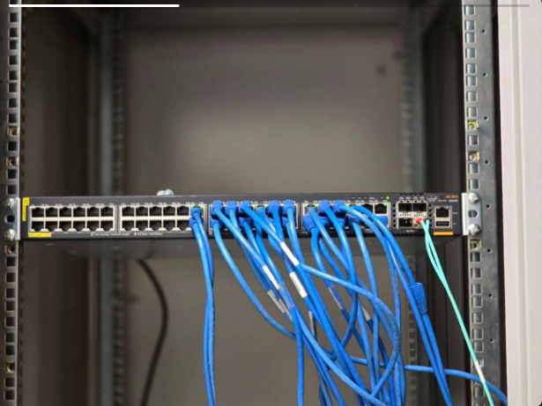
Switches In IDFs
Data Distribution:
Switches connect to endpoint devices like computers, phones, and printers via structured cabling.
They forward data packets only to the intended recipient device, ensuring efficient data flow.
Connectivity Management:
Provide multiple ports to connect devices within the same local area network (LAN).
Aggregate traffic from multiple devices to a single uplink connecting to the Main Distribution Frame (MDF).
VLAN Support:
Allow for the creation of Virtual Local Area Networks (VLANs), enabling network segmentation for better security and traffic management.
Power Over Ethernet (PoE):
Many switches support PoE, providing power to connected devices like IP phones, cameras, and access points without needing separate power supplies.

Slide 18
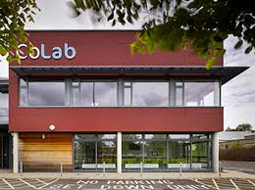
Implementation of IDFs in our network
Level 1 IDF_1A Room IDF_1B Room IDF_2C Room
Level 2 IDF_2A Room IDF_2B Room IDF_2C Room IDF_3D Room
Level 3 IDF_3A Room IDF_3B Room IDF_3C Room
CoLab
Level 1 IDF_CL1 Room
Level 2 IDF_CL2 Room

Slide 19
Wireless Network Design
Key Features:
Wireless integration with a wired backbone
240 Aruba Access Points: Full campus coverage with no "dead zones".
Wi-Fi 6 & 6GHz Band
High Speed performance
Reduced interference and congestion
Future scalability
Strategic Placement
Libraries, labs, lecture halls and outdoor areas.

Slide 20
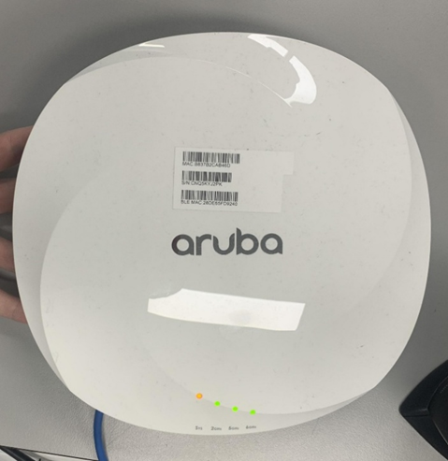
Aruba Access Points
Why Aruba Access Points?
We selected Aruba Access Points due to their superior features such as:
Wide coverage and high capacity
Tri-band support for 6GHz bands.
Handles heavy traffic in high-density areas.
Placement Highlights:
The Access Points will be placed on ceilings or high walls to maximize signal reach and minimize interference.
High-density APs: Library and lecture halls
Standard APs: Classrooms, offices and labs
Outdoor-grade APs: Open spaces
This layout will ensure a seamless roaming and consistent wireless performance.

Slide 21
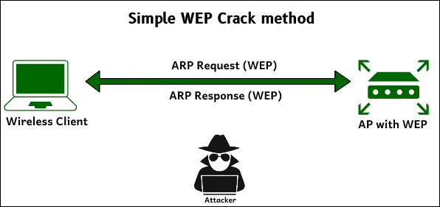
Wired Equivalent Privacy
Encrypts the data to protect Wi-Fi transmission so that outsiders will not be able to read the messages or data within . This process uses static encryption keys to provide confidentiality for the data.
Advantages
Compatible with older devices
Easy to set up and configure
Disadvantages
Static encryption keys tends to be weak
Outdated

Slide 22
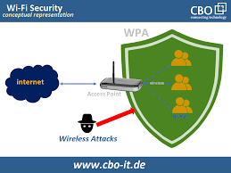
WI-FI Protected Access
Uses dynamic encryption keys with stronger authentication mechanisms.. There are multiple different versions:
WPA
WPA2
WPA3
Advantages
Strong encryption
WPA2 + WPA3 are widely supported by modern devices
Disadvantages
Limited compatibility with older devices
Higher overhead compared to WEP

Slide 23
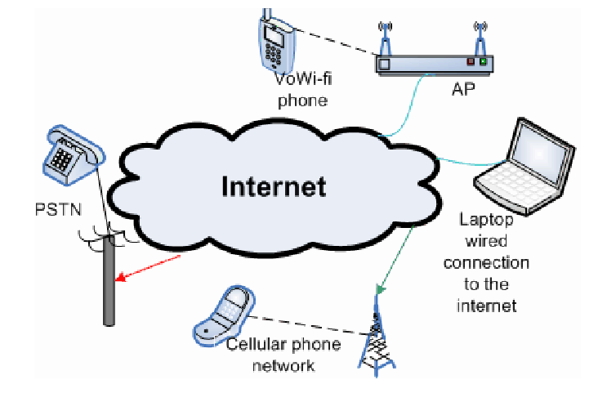
Voiceover ip
VoIP enables phone calls over an internet connection instead of the traditional phone lines by converting audio into digital data. It supports compatibility with regular telephone networks by converting signals as needed
Key Benefits
Flexibility: Calls can be made from anywhere with an internet connection
Mobility: Ideal for remote work

Slide 24
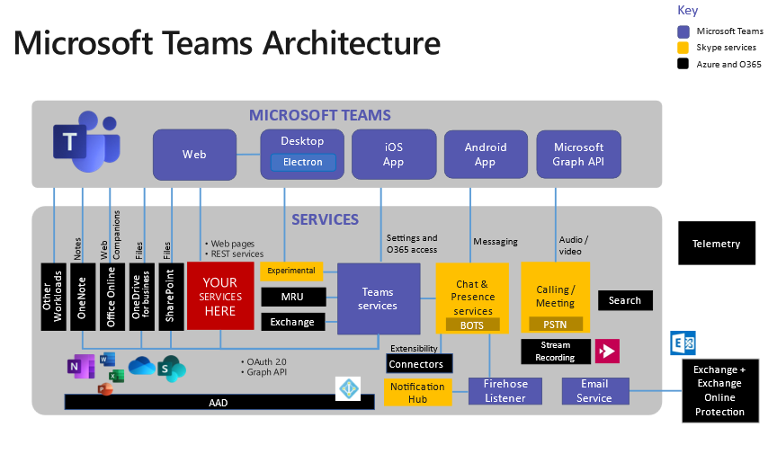
Microsoft Teams
A cloud-based collaboration platform chosen for the campus due to its seamless integration with existing Microsoft products and cloud infrastructure.
Features
Persistent chat: Enables continuous communication with individuals or groups
Collaboration: Supports departmental and organizational groups for focused discussions.
Meetings: Centralized platform for scheduling and hosting virtual gatherings
PSTN Integration: Functions as a full telephone system, allowing calls over traditional phone lines.
Benefits:
Aligns with campus cloud-based infrastructure.
Enhances accessibility, scalability and centralized communication.

Slide 25
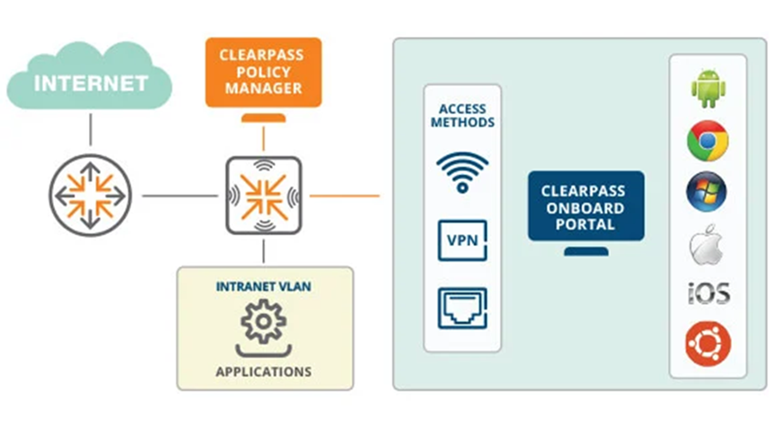
ClearPass
Aruba's ClearPass platform secures the college network by granting access based on roles, device type and cybersecurity posture.
Functionalities
Identification: Real-time device tracking
Enforcement: Automated security policies
Protection: Health checks using ClearPass OnGuard
Integration: Works with firewalls, SIEM and MDM tools.
Benefits
Enhanced security and dynamic access control
Real-time insights for issue resolution

Slide 26
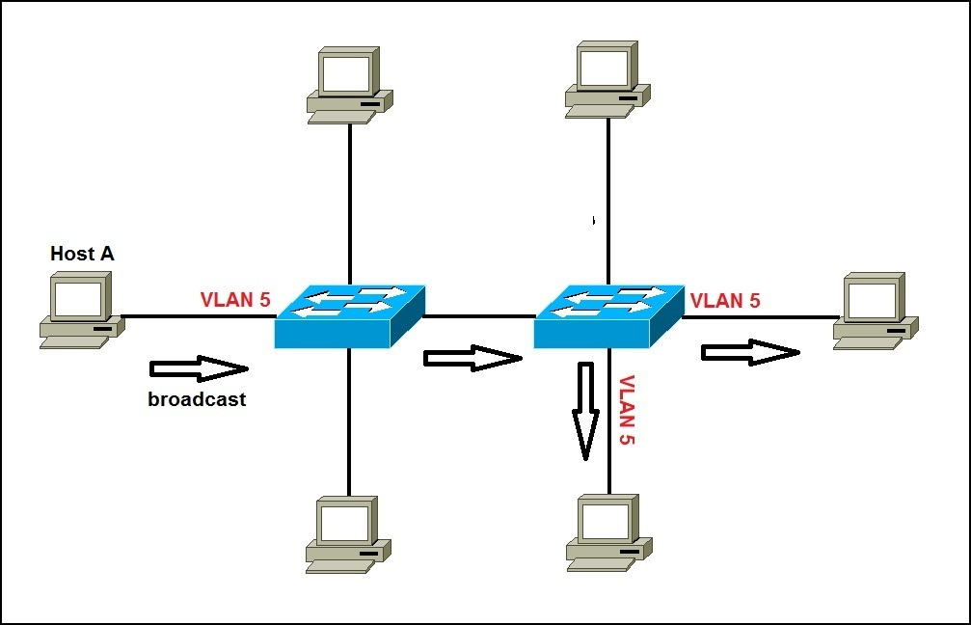
VLANS
What is a VLAN?
A Virtual Local Area Network (VLAN) is a logical group of network devices that appear to be on the same network segment, even if they're located in different physical areas.
Purpose:
Improve network performance, security, and management.
Segment network traffic, reduce broadcast traffic, and apply policies/restrictions based on user/device needs.
Benefits:
Enhances security
Simplifies management
Scalable network design

Slide 27

VLAN PLAN
Sample VLAN Plan (IDs & Descriptions):
VLAN 10- Faculty: Faculty devices (computers, APs) with access to academic resources.
VLAN 20- Students: Segregates student traffic, restricted resource access.
VLAN 30- Administration: Administrative access to university management systems.
VLAN 40- Library: Supports library management and access.
VLAN 50 - Research: High-speed access for research labs and servers.
Key Considerations for VLANs:
Security: Segmentation between departments to minimize risk.
Performance: Ensure critical VLANs (e.g., Research, VoIP) have dedicated resources to avoid congestion.
Quality of Service (QoS): Prioritize critical services (e.g., VoIP) to ensure optimal performance.

Slide 28
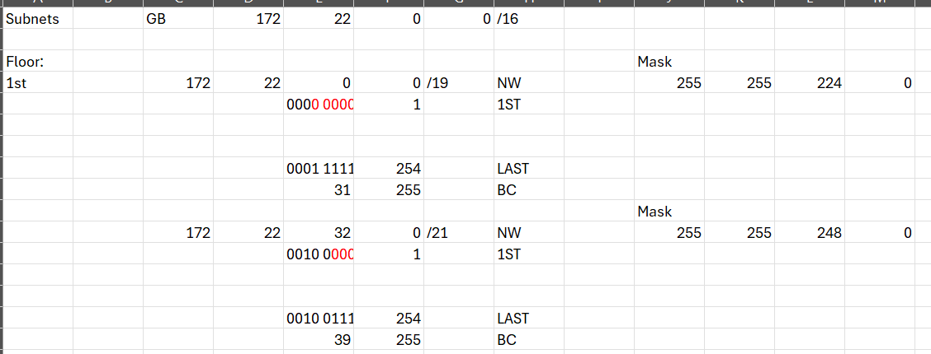
subnetting
Sample Subnetting Overview:
The 172.22.0.0/16 network is divided into smaller subnets to optimize the university's LAN performance, improve security, and streamline management.
Each subnet corresponds to different areas of the university, such as various floors and WAN connections, ensuring efficient resource allocation.
Floor 1 Subnets:
172.22.0.0/19 (First Floor):
Subnet Mask: 255.255.224.0
IP Range: 172.22.0.0 to 172.22.31.255
Usage: Supports large number of devices for faculty and administrative staff, computers, printers, and wireless access points (APs) on the first floor.
172.22.32.0/21 (First Floor):
Subnet Mask: 255.255.248.0
IP Range: 172.22.32.0 to 172.22.39.255
Usage: Provides additional IP addresses for classrooms and other devices on the first floor.

Slide 29
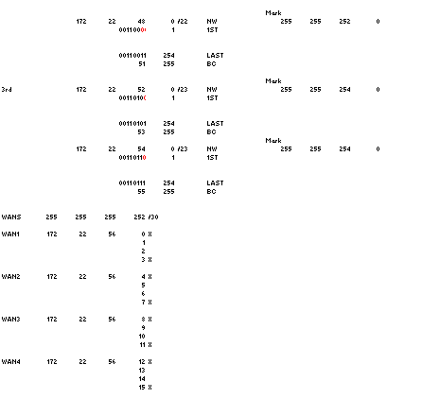
subnetting
Floor 2 Subnets:
172.22.40.0/21 (Second Floor):
Subnet Mask: 255.255.248.0
IP Range: 172.22.40.0 to 172.22.47.255
Usage: Dedicated to computer labs, student workstations, and faculty offices on the second floor.
172.22.48.0/22 (Second Floor):
Subnet Mask: 255.255.252.0
IP Range: 172.22.48.0 to 172.22.51.255
Floor 3 Subnets:
172.22.52.0/23 & 172.22.54.0/23 (Third Floor):
Subnet Mask: 255.255.254.0
IP Range (each): 172.22.52.0 to 172.22.53.255 & 172.22.54.0 to 172.22.55.255
WAN Subnets (For University-wide Connectivity):
172.22.56.0/30 to 172.22.56.23/30:
Subnet Mask: 255.255.255.252
Usage: Supports point-to-point connections between university campuses or WAN links for data transfer between buildings. Each subnet provides two usable IPs for router-to-router communication.

Slide 30


Security
ATU Donegal's servers are integral to academic, research, and administrative operations. They are protected by multi-layered security measures to ensure resilience against unauthorized access, data breaches, and service disruptions.
Server Hardening:
Only essential software is installed. Remote access is restricted, and servers are regularly updated to stay secure.
2. Authentication and Access Control:
Admin access requires Multifactor Authentication (MFA), and sensitive data is only accessible to approved users. All access is tracked and monitored for unusual activity.
3. Firewall Integration:
Firewalls block unauthorized traffic, and servers are grouped by purpose with strict controls on communication.

Slide 31

4. Data Protection
Data is encrypted both when stored and during transfer. Regular backups are encrypted and stored in multiple locations.
5. Application Security
Systems are kept safe through regular reviews, validation checks, and updates.
6. Virtualization and Cloud Security
Virtual machines run separately for safety, and cloud servers have strict access controls and encryption.

Slide 32
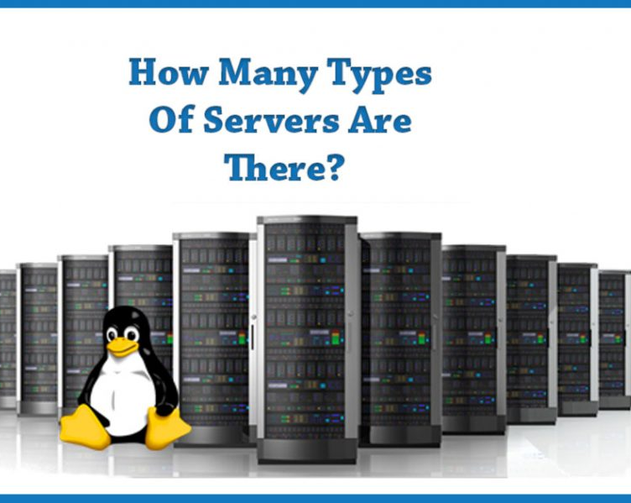
Server
TYPES OF SERVERS
The servers at ATU Donegal are varied to cater to different needs within the institution:
File Servers: Store shared academic and administrative resources.
Web Servers: Host websites for the university.
Email Servers: Enable secure communication for staff and students.
Database Servers: Manage key data like student records.
Application Servers: Run learning tools like Moodle and research applications.
Backup Servers: Safely store copies of important data.

Slide 33

2. Server Infrastructure
The server infrastructure in here has been designed to be reliable, scalable, and high performance:
Data Center: Built for reliability with backup power, cooling, and strong security.
Network Connectivity: A fast, redundant network ensures smooth communication.
Scalability: Servers can easily expand with new storage, virtual servers, or cloud services.
Redundancy: Systems have fail-safes like RAID storage and backup power to keep them running.
3. Server MANAGEMENT
Monitoring and Maintenance: Systems are checked 24/7 and updated regularly to stay reliable.
Configuration Management: Standard settings help prevent mistakes and keep servers stable.
Resource Utilization: Virtualization helps make the best use of server resources.

Slide 34


4.Server Software and Services
ATU Donegal's servers support diverse academic and administrative activities through a range of systems and applications:
Operating Systems: Linux and Windows Server host diverse university services.
Database Management Systems: Platforms like MySQL and PostgreSQL handle large datasets.
Collaboration Tools: Facilitate email, file sharing, and project management.
Learning Management Systems (LMS): Moodle and Blackboard enable academic collaboration.
5. Backup and Disaster Recovery
ATU Donegal has dedicated backup servers that mirror critical data from other servers to ensure data integrity within the university. It does regular backups of server configurations, applications, and data so that in case failure occurs, the university would be able to recover and restore services faster.
Backups: On-site and off-site encrypted backups ensure data integrity and quick recovery.
Disaster Recovery Plans: Restore systems promptly during failures, minimizing operational disruptions.

Slide 35
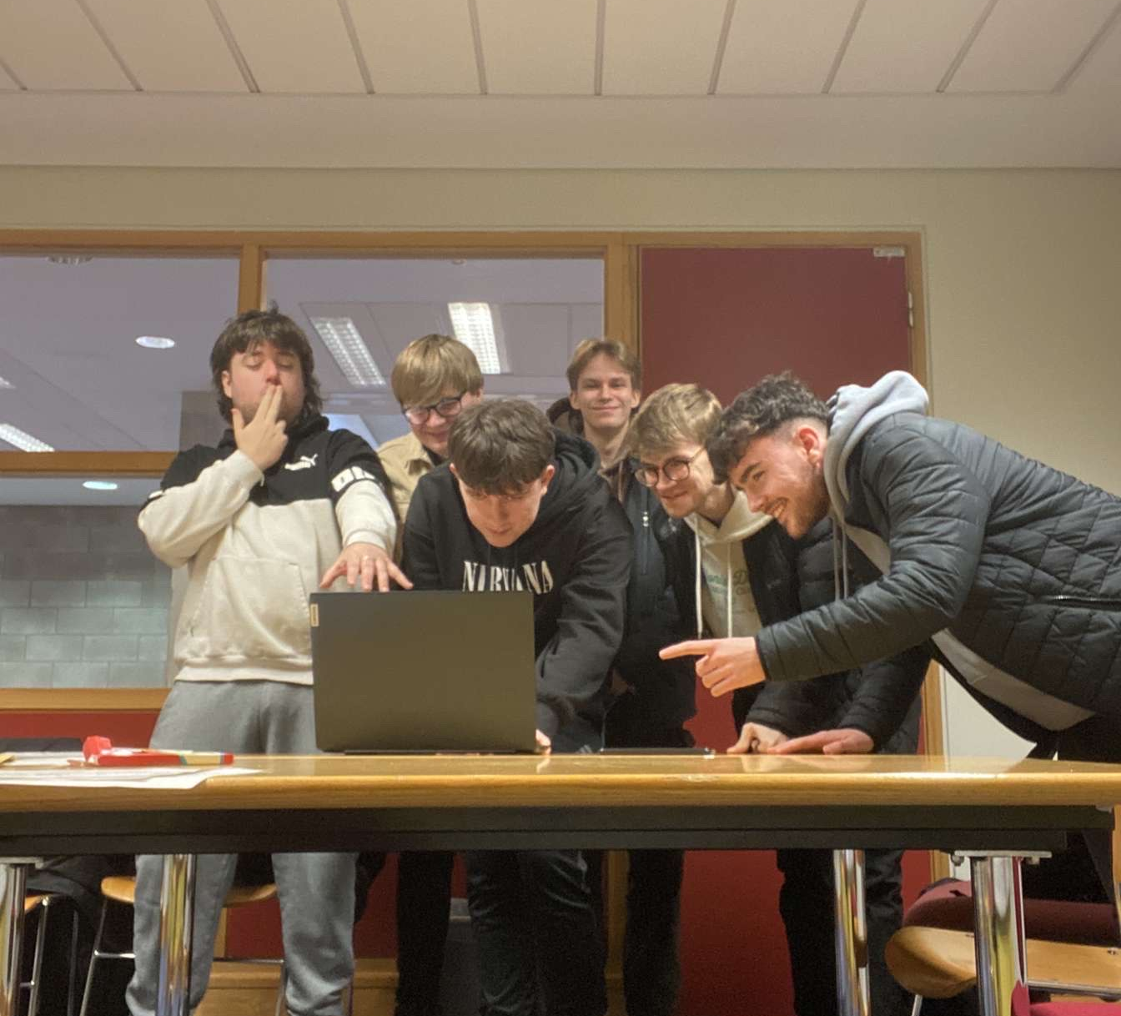
Conclusion
The completion of this LAN design project for Letterkenny ATU has demonstrated the importance of a well-structured and secure network infrastructure while also being highly beneficial for us as a group. The project provided a practical understanding of network design principles as a whole.
As a group, this project allowed us to collaborate effectively, playing on each member's strengths and expertise. The teamwork improved our communication and problem-solving skills as we coordinated tasks, shared feedback, and addressed real-world challenges together.

Slide 36


